Slide 1




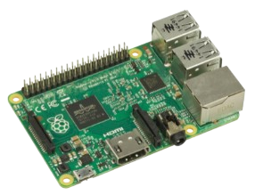
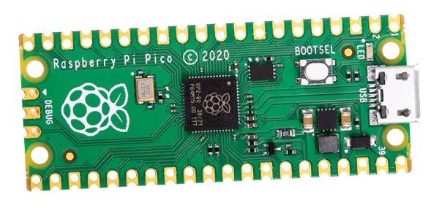

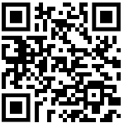

About us
Contact us
Raspberry Pi Weather Monitor
Lynn Palmer - Team Sponsor
A member at Victoria PiMakers, offers the resources and support that enable us to develop this system
Brendan Caldwell - Back-End Developer
Specializes in building robust server-side applications
Caleb Olsen - Full-Stack Developer
Integrates front-end and back-end technologies to create seamless user experiences
Pei-Fan Ho - Front-End Developer
Designs user-friendly interfaces with a focus on engaging web applications
Victoria PiMakers
vicpimakers-join@vicpimakers.ca
Brendan Caldwell
(250) - 217 8450
brendancaldwell519@gmail.com
Caleb Olsen
(250) - 886 8364
CalebOlsen34@gmail.com
Pei-Fan Ho
(250) - 880 8128
npoint122@hotmail.com
GitHub
Learn More
github.com/ldpalmer62/CamosunCapstone

Slide 2
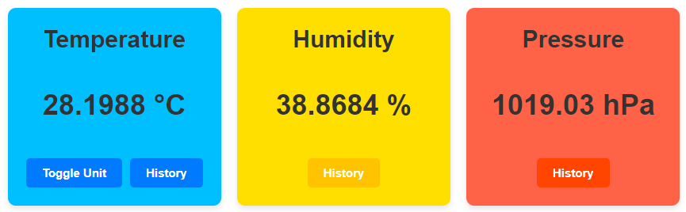
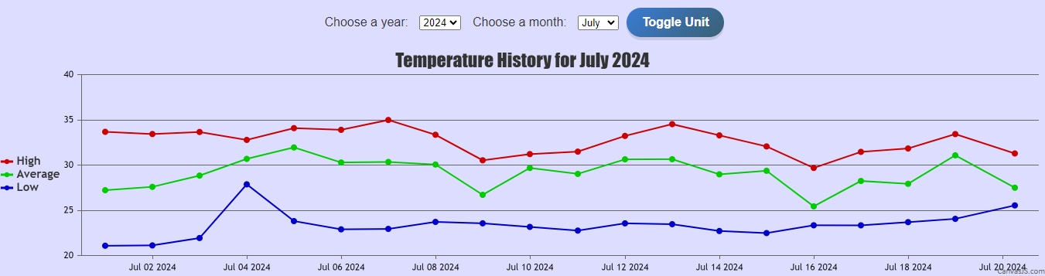
Overview
Live
Weather Data
Features
Users can monitor the weather in remote locations using the Raspberry Pi and the Raspberry Pi Pico.
The Pi Pico periodically reads weather data from a sensor and sends the data to the Raspberry Pi to store it.
The weather data is displayed to the user via a web page.
Everything runs entirely on local computers and devices, without using any online services.
Easy to set up
Educational
Affordable
Open Source
No paid software required
Check the temperature, humidity, and pressure at your convenience.
Weather History
This is real-time data you will see on the history.

